Slide 1
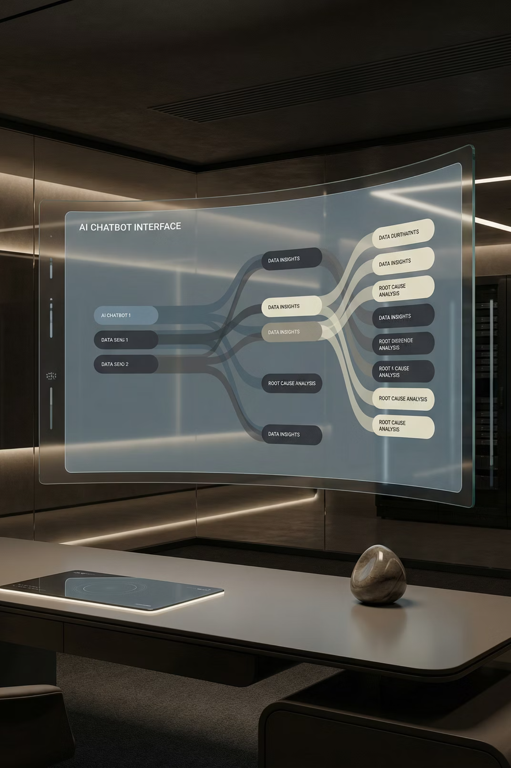
AI-Driven ChatBot for RCA and Data Insights
Multi-Agent, RAG, and MCP-Enabled Backend Architecture

Slide 2

The Challenge: Manual Bottlenecks in RCA and Data Access
Traditional methods for Root Cause Analysis (RCA) and data querying are often characterized by significant pain points:
Time-Consuming Manual Processes: Sifting through vast log files and databases is slow and error-prone.
Lack of Automation: Repetitive tasks consume valuable engineering hours.
Delayed Insights: Business users face delays in getting critical data insights, impacting decision-making.
Inaccurate Outcomes: Human error can lead to incorrect RCA or misinterpreted data.
We need a solution that brings automation, speed, and accuracy to these critical functions.

Slide 3

High-Level System Overview
Our AI-powered ChatBot intelligently routes user prompts to specialized backend services.
Response returns
User interacts
Service -> UI -> user
User submits a query
End-to-end ChatBot Flow
Data Service
ChatBot UI
Provides data-backed responses
Captures and sends query
RCA Service
Router Agent
Handles root-cause analysis
Directs query to service
This streamlined architecture ensures that user requests are handled by the most appropriate AI agent, delivering precise and timely responses.

Slide 4
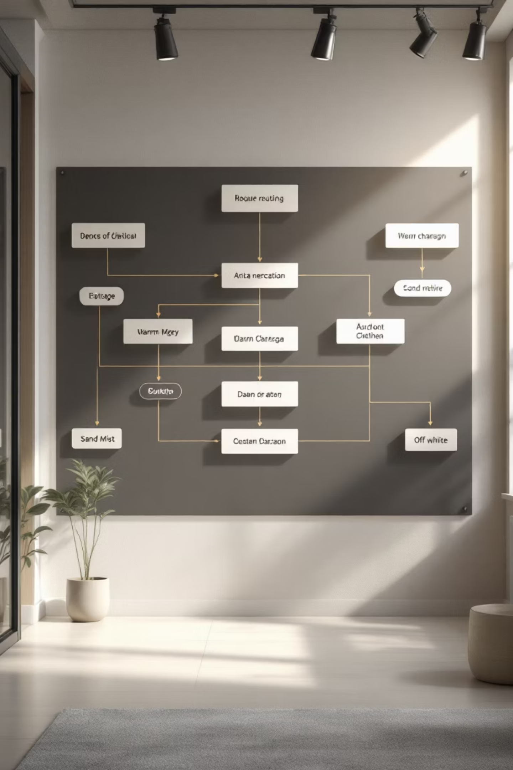

Router Agent: Intelligent Intent Classification
The Router Agent is the brain of our system, discerning user intent to direct queries effectively.
Intent Detection Logic
Dynamic Routing Flow
Based on classified intent, the Router Agent forwards the prompt to either the RCA Service or the Data Service.
Utilizes advanced NLP models to classify user prompts into categories like RCA, Data Query, or general inquiries.
Classification Examples
"Why did user 'X' transaction fail?" → RCA Service
"Show me sales figures for Q3." → Data Service

Slide 5
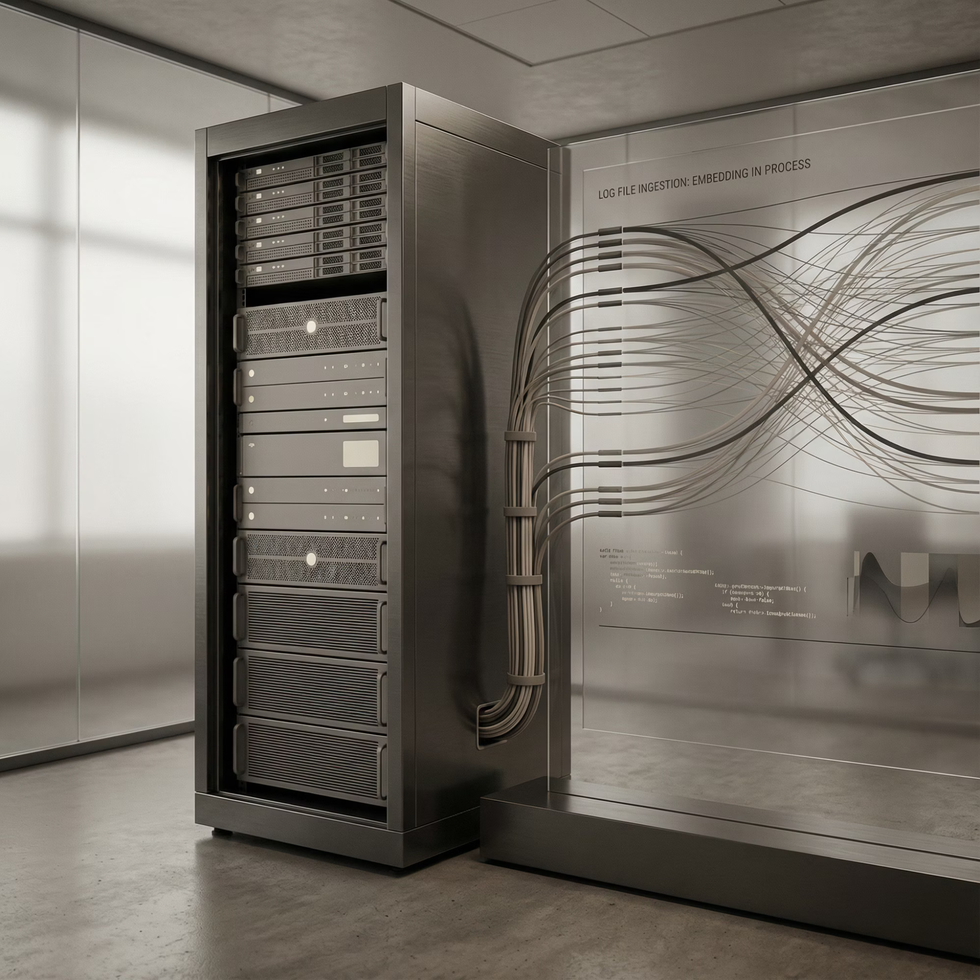

RCA Service: Grounded Root Cause Analysis with RAG
The RCA Service leverages Retrieval-Augmented Generation (RAG) to provide accurate and context-rich root cause analysis.
In-depth Log Ingestion & Embedding
Vector DB & Metadata-Based Retrieval
Logs are continuously ingested and transformed into high-dimensional embeddings. These vector representations capture the semantic meaning of log entries, enabling sophisticated similarity searches.
Embedded logs are stored in a Vector Database, augmented with metadata for precise filtering. This allows for rapid and relevant retrieval based on user query context, isolating pertinent log clusters.

Slide 6

RCA Service: RAG for Actionable Insights
By integrating RAG, the RCA Service goes beyond simple retrieval to generate truly insightful explanations.
01
02
Contextual Retrieval
Augmented Generation
The user query is used to retrieve relevant log embeddings from the vector database, focusing on specific timeframes or entities.
Retrieved context (logs, incident reports) is fed to a large language model (LLM) to synthesize a comprehensive RCA report.
03
Grounded Responses
The LLM generates an explanation that is not only coherent but also factually grounded in the retrieved operational data, minimizing hallucinations.
Example Query: "Why did the transaction against mobile number 8551234212 fail on March 15th at 2:30 PM PST?"

Slide 7
Data Service: Natural Language to Data Insights with MCP
The Data Service empowers business users to query complex databases using natural language, facilitated by the Model Context Protocol (MCP).
1
2
Interpreting Natural Language
MCP Client Interaction
The Data Agent translates complex English queries into structured database commands (e.g., SQL).
The interpreted query is packaged and sent via the MCP Client to the MCP Server, ensuring secure and standardized communication.
3
4
Execution via MCP Server
Formatted Response
The MCP Server executes the database commands and retrieves the requested data, handling connection pooling and security.
The results are then returned to the Data Agent, which formats them into a user-friendly response for the ChatBot.
Example Query: "Give me the last 10 transactions for user John Doe."

Slide 8
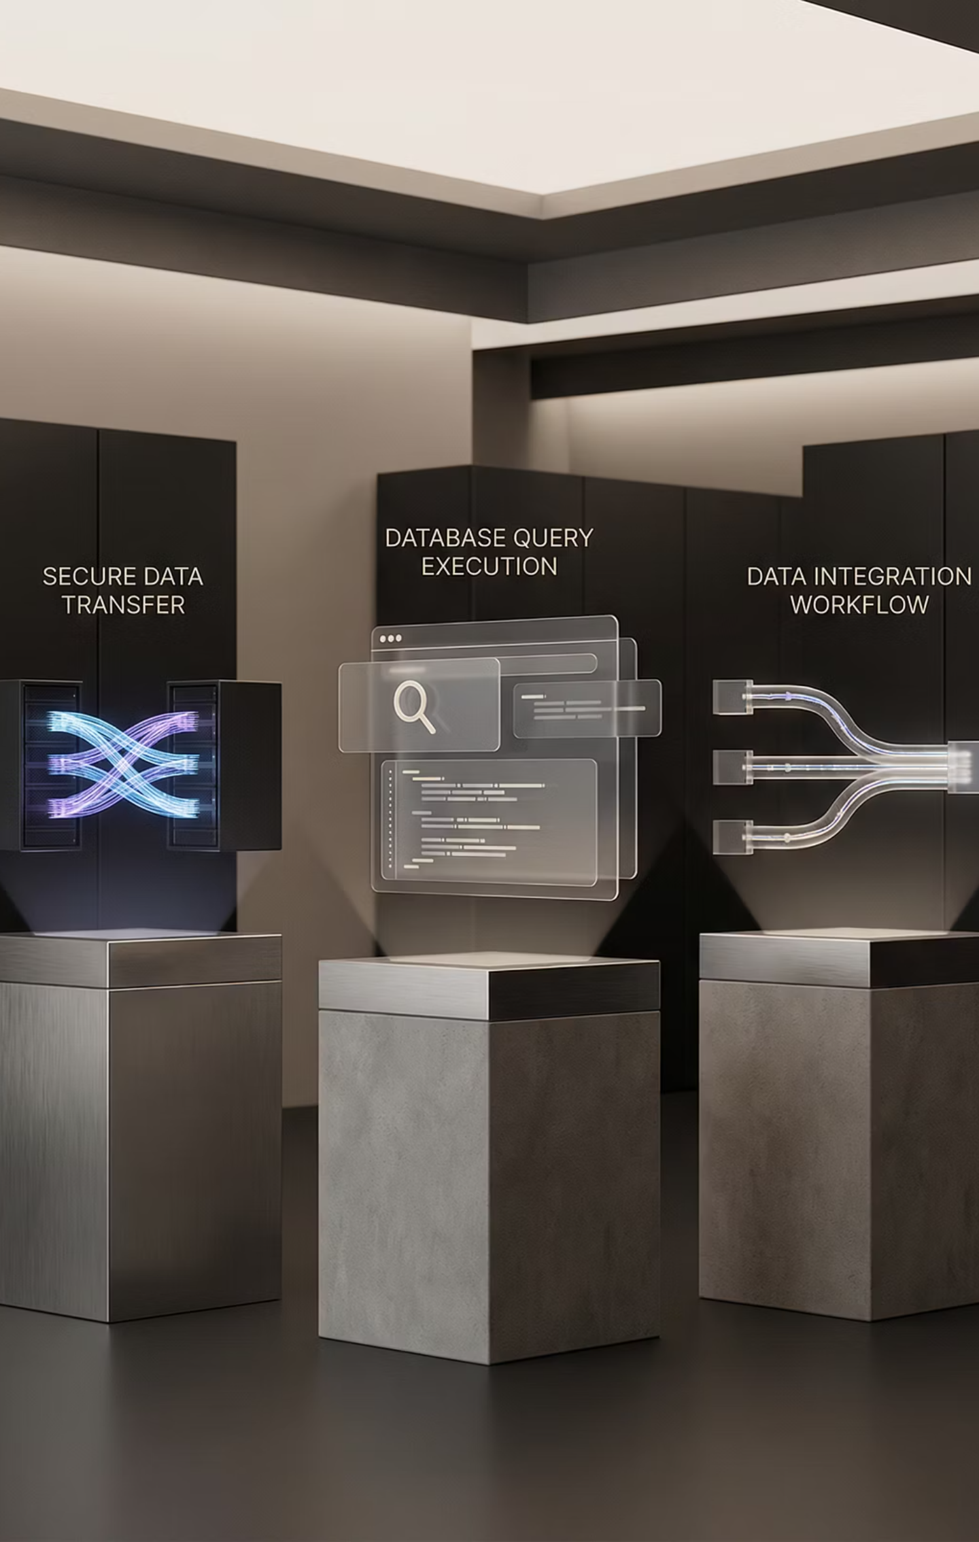

Data Service: MCP Workflow
The Model Context Protocol (MCP) orchestrates secure and efficient data retrieval.
Client receives data
MCP Client sends query
Processes and displays results
Initiates request securely
Server sends response
MCP Server receives query
MCP Data Retrieval
Packages results for client
Validates and parses request
Server queries Database
Database returns data
Provides query results
Retrieves requested records
This structured communication ensures that data queries are executed reliably and results are delivered accurately, providing immediate insights.

Slide 9




Multi-Agent Architecture: Specialization and Scalability
Our system leverages a multi-agent approach to maximize efficiency and flexibility.
Router Agent
RCA Agent
Directs incoming user queries to the appropriate specialized agent.
Performs root cause analysis using RAG, delivering detailed explanations.
Knowledge Agent
Data Agent
Provides supplementary information and context from internal knowledge bases.
Executes natural language data queries through the MCP.
This modular design enables agents to specialize in specific tasks, improving performance and allowing for independent scaling and maintenance.

Slide 10
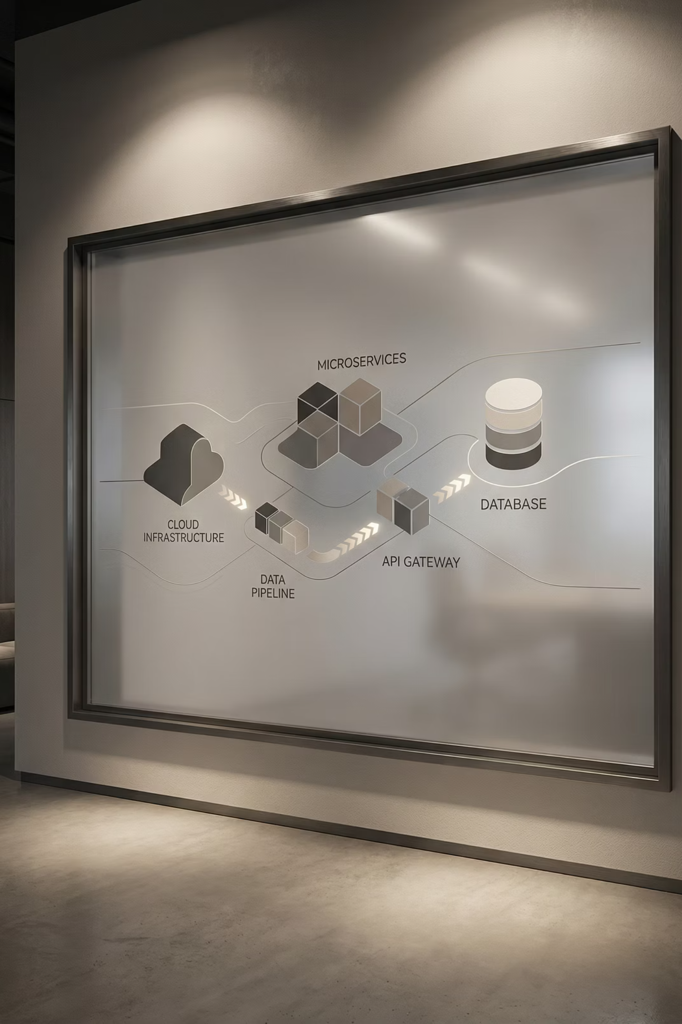
Core System Components & Technology Stack
Our robust architecture is built upon a foundation of modern technologies.
Backend
1
Python/FastAPI
Kubernetes
Microservices
AI/NLP
2
Large Language Models (LLMs)
Hugging Face Transformers
OpenAI API
Data Stores
3
Vector DB (Pinecone/Weaviate)
Elasticsearch (Log Store)
SQL/NoSQL Databases
Messaging & MCP
4
Kafka/RabbitMQ
Custom MCP Framework
RESTful APIs

